Slide 1
Streaming Anomaly Detection Urban Data Lab Capstone Project Week 4 Status
Data 599 Mitch Harris, Ryan Koenig, Nathan Smith May 25, 2021

Slide 2
Outline
Previous Week Summary (May 17-23)
Next Week Planning (May 24-30)
Timeline Reflection

Slide 3
Previous Week Summary
Week 3 Goals: Anomaly Detection Model
Data Cleaning/Feature Processing for Anomaly Detection Pipeline
Test Short-Listed Anomaly Detection Methods
Build Streaming Framework for Anomaly Detection Model with InfluxDB
Meet with Domain Experts
Start Reviewing Azure (secondary)

Slide 4
Ongoing from Week 2 Tasks Previous Week (May 17-23)
Exploratory Data Analysis - Ryan
EDA originally completed on the limited dataset
Time intensive method of downloading data
Ultimately committed to downloading 2-years of ~minute data for 5 sensors
Will continue with ~10 more sensors throughout Week 4
Additional work supporting UDL with parsing data and implementing streaming
Still in progress
Complete to the extent that it can be, ~1 week behind schedule

Slide 5
Ongoing from Week 2 Tasks Previous Week (May 17-23)
Anomaly Detection Research (and start testing) – Mitch/Ryan
Decided we needed additional time on coming up with the anomaly detection method
Risk of going down the wrong path too high (high diversity of methods)
Part of the delay was driven by uncertainty in data
Moving forward with an LSTM model
Discussed with Scott Friday
Complete but ended up being ~1 week behind schedule

Slide 6
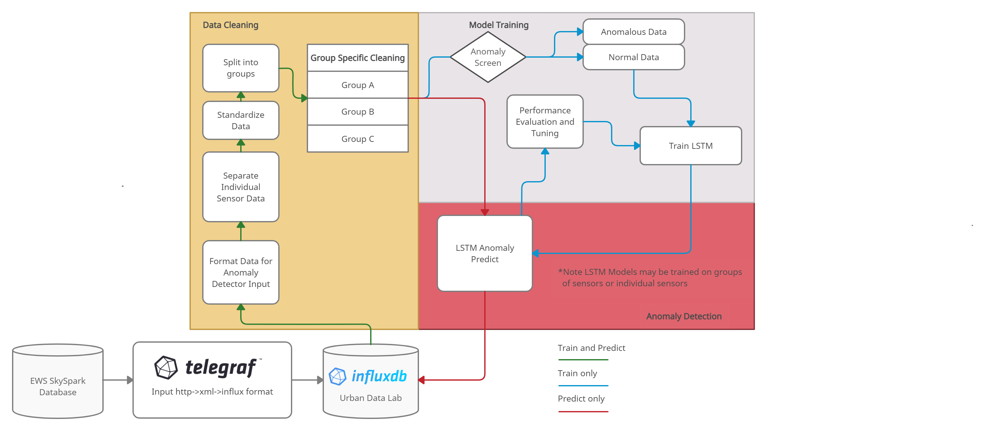
Anomaly Detection Model Previous Week (May 17-23)
Training completed weekly/monthly
Predict on ongoing basis
Trains on normal data
Allows operational adjustment
Allows new sensor to use a similar sensor trained model to start detection

Slide 7
Anomaly Detection Model Current Progress
Data Preparation
Sensors grouped
Data standardized
Anomaly Screen/Filter
Trains on normal data only – any data already labelled anomalous is removed from training
Labelling anomalies to initially train the model will be done manually
LSTM-AD
2-layers Stacked LSTM for initial model
Modify as required (such as using a sliding window)
Tuning
Changing the threshold of labelling an anomaly for preferred results or changing the period a sensor is trained on

Slide 8
New Week 3 Tasks Previous Week (May 17-23)
Build Streaming Framework - Nate
Built initial framework (code) that could work with InfluxDB/Telegraf
Includes querying/parsing/writing data
Options coded for inline Telegraf prediction or query/write from InfluxDB prediction
Stopped at a point where details on model are now required
Tests in local Docker setup successful
On track

Slide 9



New Week 3 Tasks Previous Week (May 17-23)
Anomaly Detection inline w/ Telegraf
Anomaly Detection using Query/Write
Raw
Parsed
Detected

Slide 10
New Week 3 Tasks Previous Week (May 17-23)
Meet with Domain Experts - All
Monday meeting
Sounds like we’ll be unable to get labelled data
Friday meeting
Buy-in on ~15 sensors that we’re using for the study
EWS is looking at options to get labelled anomalies
Unlikely we’ll get labelled data in a reasonable timeframe
Have the ability to meet and discuss results in Week 5
On track

Slide 11
New Week 3 Tasks Previous Week (May 17-23)
Bonus Items
Build Shiny App to Support Anomaly Labelling - Nate
Download Data and Label Anomalies – Nate/Ryan
Research Dashboards - Nate
Can most likely be done in InfluxDB which will save time
Discussion with UDL on the dashboard they are envisioning which should be reasonably easy

Slide 12
New Week 3 Tasks Previous Week (May 17-23)
Data Cleaning/Feature Engineering Pipeline
Did not get worked on with EDA behind schedule
Build/Test Anomaly Detection Frameworks
LSTM model started on but largely behind
Will be working on in coming week, 1 week behind schedule

Slide 13
New Week 3 Tasks Previous Week (May 17-23)
Review Azure
This was a secondary goal and did not get looked into
UDL agrees this is secondary
Pushing this further out (ultimately a secondary objective)

Slide 14
Client Meetings Previous Week (May 17-23)
Monday Technical Project Meeting
Discussion on streaming framework, our approach seems reasonable
Thursday Sprint Planning
Discuss data parsing and EDA issues
Plan for next week tasks

Slide 15
Challenges Previous Week (May 17-23)
Getting Data
Method is time consuming (manual csv downloads)
Complete dataset is still not easily accessible
Data Parsing to Support Streaming into InfluxDB
Support was still being provided for this
Anomaly Detection Model
Felt we needed to do additional research before moving forward

Slide 16
Challenges Previous Week (May 17-23)
Anomalies / Performance Measures
Realized that we need to do our own anomaly labelling
Didn’t build time to understand/select anomaly detection performance measures into the schedule

Slide 17
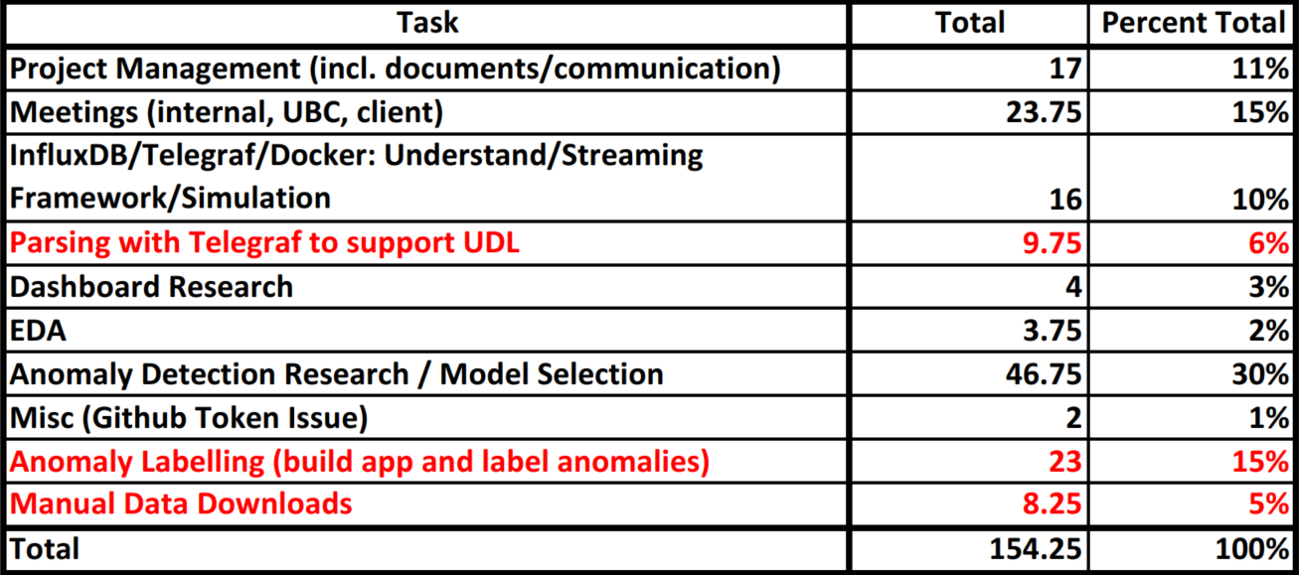
Time Summary Previous Week (May 17-23)

Slide 18
Next Week Planning
Week 4 Goals: Implement Streaming Pipeline
Streaming Anomaly Detection Pipeline
Model Tuning and Evaluate Performance
Status Presentation

Slide 19
New Goal/Tasks Next Week (May 24-30)
Week 4 Goal: Build Anomaly Detection Model
Label Anomalies and Select Performance Measures (tasks not originally considered)
Data Cleaning/Feature Pipeline
Build Anomaly Detection Model
Status Presentation
Start Implementing Detection Pipeline as Possible
Model Tuning and Evaluate Performance as Possible

Slide 20
Individual Tasks Next Week (May 17-23)
Mitch: Build Anomaly Detection Model LSTM
Ryan: Performance Measures, Anomaly Detection Cleaning/Result Pipeline
Nate: Project Management, Status Presentation, Support Mitch/Ryan as Needed (streaming framework on hold), Continue Labelling Anomalies

Slide 21
Challenges Next Week (May 17-23)
Behind where we wanted to be
Week 4 is basically Week 3 – lost float
Anomaly labelling
Hopefully it is straightforward enough

Slide 22
Timeline Reflection
Discussion on where we’re at

Slide 23
Schedule Timeline Reflection
Week 3:
Anomaly detection model not built
Streaming framework on track
Week 4:
Not implementing model yet
Added task of anomaly labelling and performance measures
Week | Goal
1 | Project Definitional and Proposal
2 | Data and System Understanding
3 | Anomaly Detection Model
4 | Implement Streaming Pipeline
5 | Value Week
6 | Dashboard
7 | Reporting

Slide 24
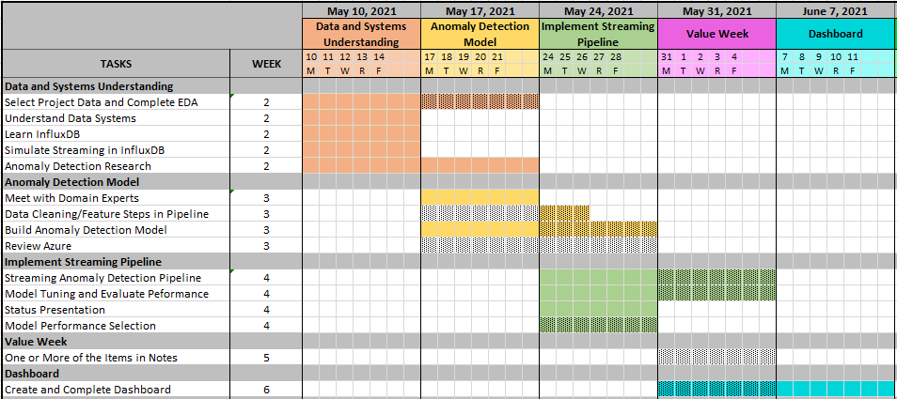
Schedule Timeline Reflection

Slide 25
Impacts to Scope Timeline Reflection
Behind where we wanted to be at the start of Week 4
Plan was:
Week 2 was research/understanding
Week 3 is testing/building
Week 4 is implementing
Week 5 is a value add/buffer week
Week 4 is becoming testing/building and Week 5 implementing – No longer have float

Slide 26

Thank You
Mitch Harris
Ryan Koenig
Nathan Smith
Photo by Markus Spiske on Unsplash

